Slide 1
NR Radio Frequency and co-existence
3GPP TSG RAN WG4 Chairman (Samsung)

Slide 2
Introduction | 3GPP RAN4 5G specifications
RF Requirements
Baseband Requirements
Test
| RF specification for UE (38.101-1/2/3) and BS (38.104)
• Operating bands and Channel arrangement
• Transmitter RF requirements
• Receiver RF requirements
| EMC specification for UE (38.124) and BS (38.113)
• EMC emission
• EMC Immunity
| MSR BS RF requirements (37.104)
• RF requirements for Multi-Standard Radio BS
| Radio Resource Management (38.133)
• Mobility
• Timing
• Measurement
| BS conformance Test
• Conducted Test (38.141-1)
• Radiated Test (38.141-2)
| NR test method (38.810)
• RF testing method
• RRM testing method
• Demodulation Testing method
| UE (38.101-4) Demod/CSI and BS (38.104) Demod
• PDSCH/PDCCH/SDR
• PUSCH/PUCCH/PRACH
• CSI/PMI/RI
• CRI
• Other PHY channel
• Other channel state information
3GPP TS 38.101-1 V0.2.0 2017.10
3GPP TS 38.104 V0.3.0 2017.10
3GPP TS 38.133 V0.3.0 2017.10
3GPP TS 38.141-1 V0.3.0 2017.10
3rd Generation Partnership Project;
Technical Specification Group Radio Access Network;
NR;
User Equipment (UE) radio transmission and reception Part 1: Rang 1 standalone
(Release 15)
3rd Generation Partnership Project;
Technical Specification Group Radio Access Network;
NR;
Base Station (BS) radio
transmission and reception
(Release 15)
3rd Generation Partnership Project;
Technical Specification Group Radio Access Network;
NR;
Requirements for support of radio resource management
(Release 15)
3rd Generation Partnership Project;
Technical Specification Group Radio Access Network;
NR;
Base Station (BS) conformance testing;
Part1: Conducted conformance testing
(Release-15)
2

Slide 3


Content
NR System Parameters
Spectrum/NR bands
Channel Bandwidth
Spectrum Utilization
Guardband and Channel spacing
Channel Raster
NR Radio Frequency Parameters

Slide 4






System Parameters| Spectrum
5G Candidate frequency bands for ITU-R WRC-19 (Nov. 2019)
New 5G frequency allocation status
FR1 (450MHz – 6GHz)
FR2 (24.25GHz – 52.6GHz)
1.427
1.518
3.4
4.495
3.6
4.8
24.25
27.5
31.8
33.4
37
40.5
42.5
43.5
45.5
47
50.2
50.4
52.6
66
76
81
86
0.091
0.2
3.25
1.6
3.5
2
1
1.5
3
2.2
10
5
(GHz)
1.4GHz
3.5GHz
4.5GHz
20GHz
30GHz
40GHz
50GHz
60GHz
70GHz
80GHz
90GHz
[IMT Spectrum] (1.427-1.518), (3.4-3.6)
[WRC-19 Candidates] (24.25-27.5), (31.8-33.4), (37-40.5), (40.5-42.5), (42.5-43.5), (45.5-47), (47-47.2), (47.2-50.2), (50.4-52.6), (66-76), (81-86)GHz
USA
Europe
China
Japan
Korea
n77 | 3.3 – 4.2 GHz
n78 | 3.3 – 3.8 GHz
n79 | 4.4 – 5.0 GHz
n257 | 26.5 – 29.5 GHz
n258 | 24.25 – 27.5 GHz
n260 | 37 – 40 GHz
n261 | 27.5 – 28.35 GHz
· 27.5 - 28.35GHz
· 37 - 38.6GHz
· 38.6 - 40GHz
· 37 – 43.5 GHz
· 3.4 – 3.8GHz
· 24.25 – 27.5GHz
· 3.3 – 3.6GHz
· 4.8 – 5.0GHz
· 24.25 – 27.5GHz
· 37 – 42.5GHz
· 3.6 - 4.2GHz
· 4.4 - 4.9GHz
· 27.5 - 29.5GHz
· 3.4 – 3.7GHz
· 26.5 – 29.5GHz

Slide 5
System Parameters| NR Band Numbering
Use prefix “n” to differentiate from E-UTRA bands and UTRA bands
New bands for NR are assigned band numbers on a “first come first served” basis in reserved ranges regardless of duplex mode
Reserved range is 65-256 for NR FR1 bands, 257-512 for NR FR2 bands
NR operating Band | Uplink (UL) operating band | Downlink (DL) operating band | Duplex Mode
n1 | 1920MHz – 1980MHz | 2110MHz-2170MHz | FDD
: | : | : | :
n77 | 3300MHz-4200MHz | 3300MHz-4200MHz | TDD
: | : | : | :
n257 | 26.5GHz – 29.5GHz | 26.5GHz – 29.5GHz | TDD
: | : | : | :
n512 | : | : | :
LTE Refarming Bands
NR FR1 new bands
NR FR2 new bands

Slide 6
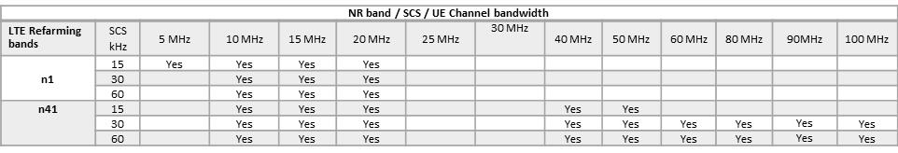
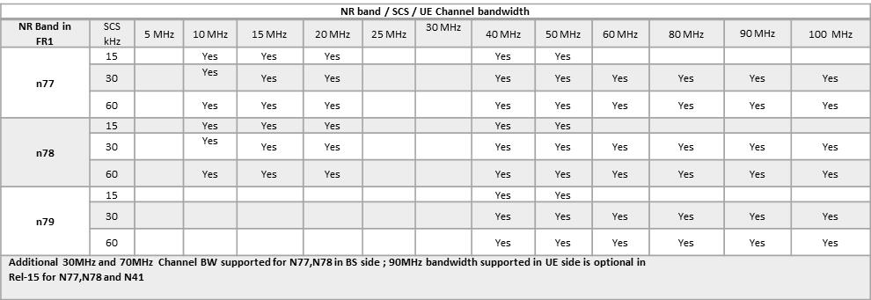
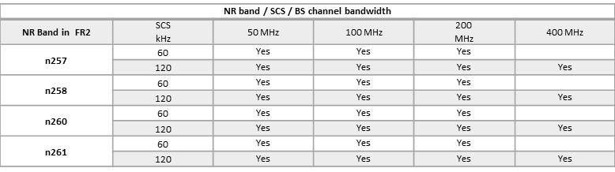
System Parameters | Channel Bandwidth
Fixed 15KHz SCS in LTE → Flexible SCS in NR
Channel bandwidths depends on data subcarrier spacing (SCS) and frequency ranges
Maximum Channel BW is specified assuming not over 3300 SC carriers and 4K FFT
All channel bandwidth specified are mandatory except 90MHz in FR1 and 400MHz in FR2
UE capability of supporting channel bandwidth is per band per SCS
Separated capability for DL and UL. UE can operate with asymmetric UL and DL bandwidths
New channel bandwidth can be added in the future release

Slide 7
System Parameters | Spectrum Utilization
Spectrum Utilization (SU) is specified as Transmission Resource Block (RB) configuration in RAN4 specifications
Spectrum utilization is specified as per combination of {CHBW, SCS}
No specific waveform confinement technologies assumed (filtering, windowing, hybrid of them) for evaluating feasible SU
Overall >90% SU achieved, maximum achieved SU are 98.3% for FR1 and 95% for FR2
Spectrum Utilization is specified considering the forward compatibility
RAN4 defines a single set spectrum utilization (SU) values in Rel-15 for DL and UL
All the requirements defined in RAN4 based on Rel-15 SU
Meanwhile allow flexibility with higher values than RAN4 in RAN1/RAN2 protocol design
SCS (kHz) | 5 MHz | 10 MHz | 15 MHz | 20 MHz | 25 MHz | 30 MHz | 40 MHz | 50 MHz | 60 MHz | 70 MHz | 80 MHz | 90 MHz | 100 MHz
 | N_{RB} | N_{RB} | N_{RB} | N_{RB} | N_{RB} | N_{RB} | N_{RB} | N_{RB} | N_{RB} | N_{RB} | N_{RB} | N_{RB} | N_{RB}
15 | 25 | 52 | 79 | 106 | 133 | 160 | 216 | 270 | N.A | N.A | N.A | N.A | N.A
30 | 11 | 24 | 38 | 51 | 65 | 78 | 106 | 133 | 162 | 189 | 217 | 245 | 273
60 | N.A | 11 | 18 | 24 | 31 | 38 | 51 | 65 | 79 | 93 | 107 | 121 | 135
SCS (kHz) | 50 MHz | 100 MHz | 200 MHz | 400 MHz
 | NRB | NRB | NRB | NRB
60 | 66 | 132 | 264 | N.A
120 | 32 | 66 | 132 | 264

Slide 8
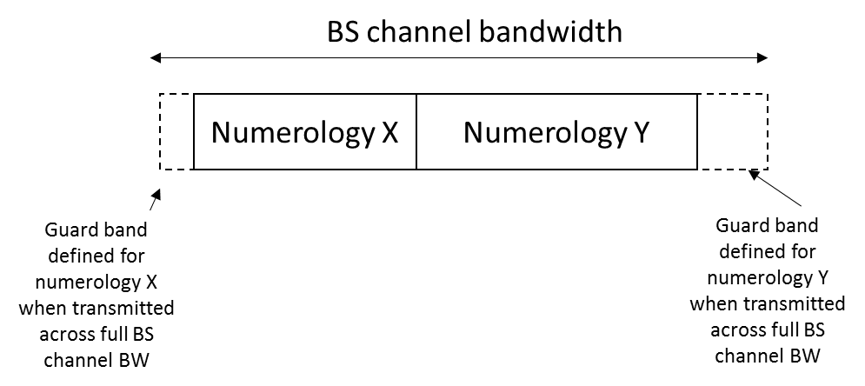


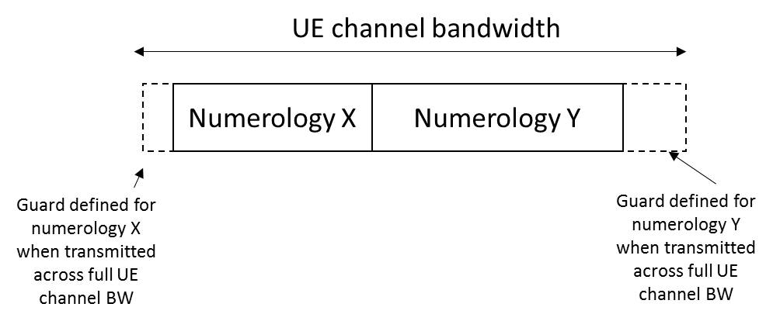
System Parameters | Guardband and Channel Spacing
Minimum guardband is specified based on channel bandwidth and transmission bandwidth configuration
Minimum guardband for mixed numerologies is also specified
Nominal Channel spacing for CA are also specified for different channel raster (100KHz, 15KHz, 60KHz)
Minimum Guardband
GB for mixed numerologies
Channel Spacing
Minimum guard-band = (CHBW – SCS*12*NRB)/2- SCS/2

Slide 9
System Parameters | Channel Raster
The channel raster defines RF reference frequencies to identify channel position for both DL and UL
A global frequency raster is defined between 0 -100GHz as NR-ARFCN
The granularity of the global frequency raster is ΔFGlobal :
For FR1 below 3GHz: 5kHz
For FR1 above 3GHz: 15kHz
For FR2: 60kHz
The RF channel positions on the channel raster in each NR operating band are given through the applicable NR-ARFCN
Band specific raster granularity ΔFRaster, which may be equal to or larger than ΔFGlobal :
FR1: LTE reframing bands except band 41, 100kHz aligned with LTE
FR1: New frequency ranges above 3GHz and band 41: SC based 15kHz, 30kHz
FR2: SC based 60kHz, 120kHz
Similar global raster and band specific raster concept is also used to define Sync Raster

Slide 10
Content
NR System Parameters
NR RF Parameters
Transmitter Power
Unwanted Emission
REFSENS
ACS

Slide 11
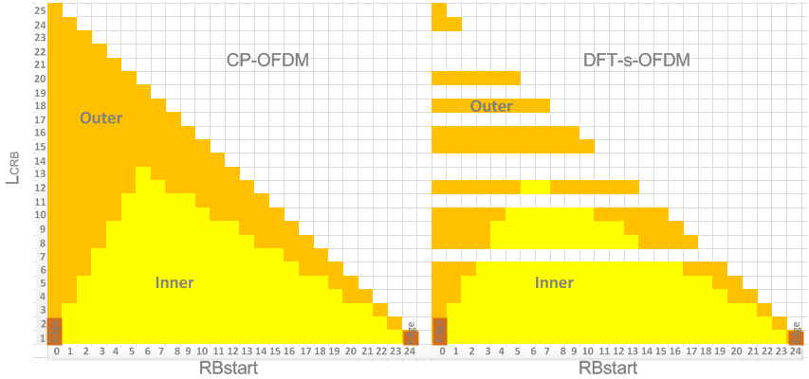
Transmitter Power| UE FR1(38.101-1)
Power class (PC)
Power class 3: 23dBm
Power class 2: 26dBm
Power class 3 is default power class
Maximum Power Reduction (MPR)
UE is allowed to reduce the maximum output power due to higher order modulations and transmit bandwidth configurations
For certain waveform and modulation scheme combination, MPR is defined according to RB allocation range, i.e., outer RB allocation and inner RB allocation
Additional Maximum Power Reduction (A-MPR)
Additional maximum power reduction (A-MPR) is allowed to meet additional emission requirements which can be signalled by the network (NS value)
Configured transmitted power (Pcmax)
The UE is allowed to set its configured maximum output power within the bounds, i.e., range of Pcmax
MPR, A-MPR and Pcmax are also specified for CA, DC, SUL and UL-MIMO
NR band | Class 1 (dBm) | Tolerance (dB) | Class 2 (dBm) | Tolerance (dB) | Class 3 (dBm) | Tolerance (dB)
n1 |  |  |  |  | 23 | ± 2
n2 |  |  |  |  | 23 | ± 2³
n3 |  |  |  |  | 23 | ± 2³
n5 |  |  |  |  | 23 | ± 2
n7 |  |  |  |  | 23 | ± 2³
n8 |  |  |  |  | 23 | ± 2³
n12 |  |  |  |  | 23 | ± 2³
n20 |  |  |  |  | 23 | ± 2³
n25 |  |  |  |  | 23 | ± 2
n28 |  |  |  |  | 23 | +2 / - 2.5
n34 |  |  |  |  | 23 | ± 2
n38 |  |  |  |  | 23 | ± 2
n39 |  |  |  |  | 23 | ± 2
n40 |  |  |  |  | 23 | ± 2
n41 |  |  | 26 | +2/-3³ | 23 | ± 2³
n50 |  |  |  |  | 23 | ± 2
n51 |  |  |  |  | 23 | ± 2
n66 |  |  |  |  | 23 | ± 2
n70 |  |  |  |  | 23 | ± 2
n71 |  |  |  |  | 23 | +2 / - 2.5
n74 |  |  |  |  | 23 | ± 2
n77 |  |  | 26 | +2/-3 | 23 | +2/-3
n78 |  |  | 26 | +2/-3 | 23 | +2/-3
n79 |  |  | 26 | +2/-3 | 23 | +2/-3
n80 |  |  |  |  | 23 | ± 2
n81 |  |  |  |  | 23 | ± 2
n82 |  |  |  |  | 23 | ± 2
n83 |  |  |  |  | 23 | ± 2/-2.5
n84 |  |  |  |  | 23 | ± 2
n86 |  |  |  |  | 23 | ± 2

Slide 12
Transmitter Power| FR2 UE and EN-DC (38.101-2 and 38.101-3)
Power class definition package for FR2 UE
Minimum peak EIRP-> UL coverage for network link budget
Maximum TRP-> UL interference restriction
Maximum EIRP-> Regulatory requirement
EIRP at certain % of CDF-> Spatial coverage
MPR, A-MPR and Pcmax are specified for each power class for FR2 UE
MPR, A-MPR and Pcmax are also specified for CA and UL-MIMO
Transmitter power including Power class, MPR, A-MPR and Pcmax are also defined for EN-DC UE
PC# | Min Peak EIRP (dBm) |  | Spherical coverage |  | Max. EIRP (dBm) |  | Max. TRP (dBm) |  | UE type
 | 28GHz | 39GHz | 28GHz | 39GHz | 28GHz | 39GHz | 28GHz | 39GHz
1 | 40.0 | 38.0 | 32.0dBm@85% | 30.0dBm@85% | 55 | 55 | 35 | 35 | Fixed Wireless Access (FWA) on fixed platform
2 | 29.0 | N/A | 18.0dBm@60% | N/A | 43 | N/A | 23 | N/A | Vehicle mounted UE (fixed on moving platform)
3 | 22.4 | 20.6 | 11.5dBm@50% | 8.0dBm@50% | 43 | 43 | 23 | 23 | Handheld UE
4 | 34.0 | 31.0 | 25.0dBm@20% | 19.0dBm@20% | 43 | 43 | 23 | 23 | Higher power mobile UE
Note: The spherical coverage requirements in this table are only applicable for UE which supports single band in FR2

Slide 13

Output Power| BS
Output power is specified per BS class (Wide area, Medium Range, Local area) and per BS type (BS 1-C, BS 1-H and BS 1-O)
No upper limit is defined for Wide Area BS output power
10log(NTXU,counted) is used to derive rated carrier output power from output power per TAB connector for BS 1-H
No upper limits for output power is specified for BS type 2-O in Rel-15
 | BS 1-C | BS 1-H |  | BS 1-O
 | The rated carrier output power per antenna connector | The sum of rated carrier output power for all TAB connectors for a single carrier | The rated carrier output power per TAB connector | Rated carrier TRP output power declared per RIB
Wide Area BS | No upper limit for Wide Area Base Station
Medium Range BS | ≤ 38 dBm | ≤ 38 dBm +10log(NTXU,counted) | ≤ 38 dBm | ≤ + 47 dBm
Local Area BS | ≤ 24 dBm | ≤ 24 dBm +10log(NTXU,counted) | ≤ 24 dBm | ≤ + 33 dBm

Slide 14
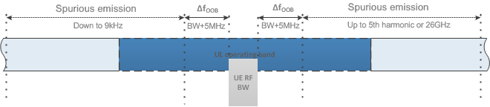
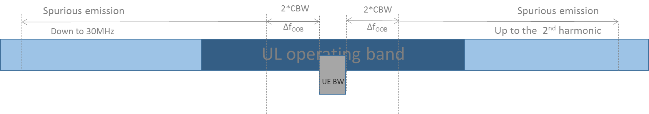
Unwanted emission| UE output RF spectrum emission
UE output RF spectrum emission consists of
Out-of-band (OOB) emission: unwanted emissions immediately outside the assigned channel bandwidth resulting from the modulation process and non-linearity in the transmitter. OOB emission is specified in terms of
Spectrum Emission Mask (SEM)
Starting from each edge of the assigned NR channel bandwidth to ±(BWchannel +5MHz) for FR1
Starting from each edge of the assigned NR channel bandwidth to ±2* BWchannel for FR2
Adjacent Channel Leakage Ratio (ACLR)
NR ACLR and UTRA ACLR for FR1
NR ACLR for FR2
Spurious emission :caused by unwanted transmitter effects such as harmonics emission, parasitic emissions, intermodulation products and frequency conversion products
Frequency range up to 5th harmonic or 26GHz for FR1
Frequency range up to 2nd harmonic range of UL operating band for FR2

Slide 15
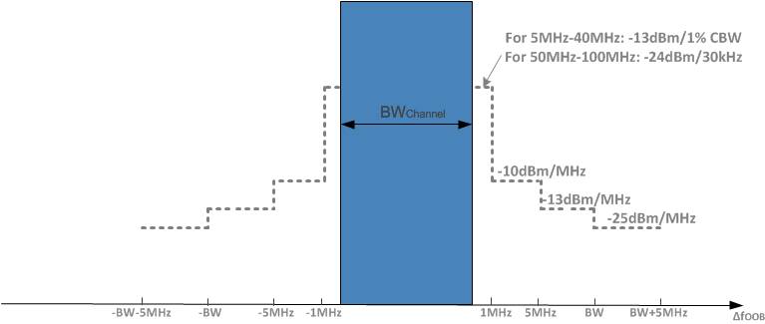
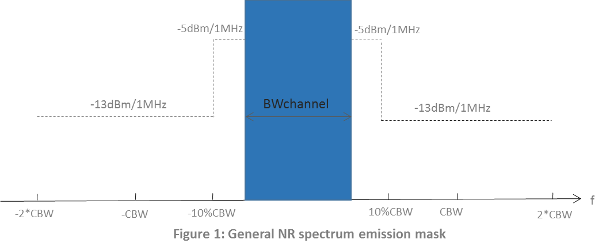
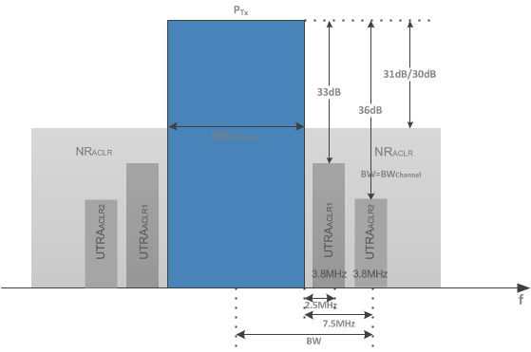
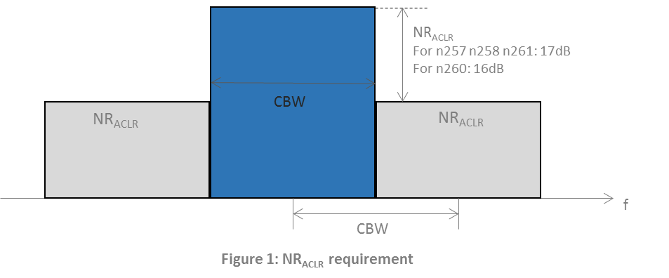
Unwanted emission| UE OOB emission
FR1 OOB Emission
FR2 OOB Emission

Slide 16
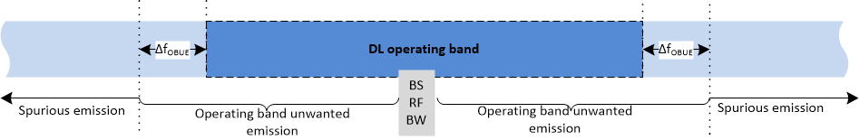
Unwanted emission| BS unwanted emissions
Basic limit and scaling
Basic limit is applied for each antenna connector as emission requirements for BS 1-C
Emission requirements are scaled by 10log10(NTXU,countedpercell) for 1-H and 9dB for 1-O except co-location requirements
No scaling is applied for FR2
BS unwanted emission consists of
Out-of-band (OOB) emission:
Operating band unwanted emissions (OBUE)
OBUE is specified as band centric manner with offset Δf_{OBUE}
Both Category A and Category B limits are specified for FR1
Adjacent Channel Leakage Ratio (ACLR)
NR ACLR1/ACLR2 are specified for FR1. LTE ACLR1/ACLR2 are specified for FR1 band also operating as E-UTRA or UTRA
Only NR ACLR1 is specified for FR2
Absolute ACLR limit or relative ACLR is applied, which is less stringent.
Spurious emission
From 9 kHz to 12.75GHz (up to 5th harmonic limit of the downlink operating band for certain bands) for FR1 (excluding OBUE region)
From 30MHz to 2nd harmonic of the upper frequency edge of the DL operating band for FR2 (excluding OBUE region)
Both Category A and Category B limits are specified for NR BS spurious emission for FR1

Slide 17
REFSENS| UE
For FR1, REFSENS power level is defined as
Sensitivity = -174dBm(kT) + 10*log(R_{X} BW) + NF + SNR +IM – diversity gain
Where RAN4 assume
- SNR = -1dB, IM (Implementation Margin) = 2.5dB, Diversity Gain = 3dB for 2Rx
- Noise Figure: 9dB for LTE refarming band; 10dB for n77 (3.3GHz – 3.8GHz), n78, n79; 10.5dB for n77 (3.8GHz- 4.2GHz)
For FR1, both 2Rx REFSENS (for all bands) and 4Rx REFSENS (for n7, n38, n41, n77, n78, n79) are defined.
For FR2, REFSENS power level is the EIS level in the RX beam peak direction.
For CA and EN-DC, additional relaxation are defined for below cases.
Band combination specific ΔRIB for FR1 inter-band CA
Aggregated Channel BW specific ΔRIB for FR2 intra-band continuous CA, i.e., 0.5dB for aggregated CHBW >800MHz
Band combination specific MSD for the band impacted by harmonic interference and intermodulation interference for CA and EN-DC.

Slide 18
REFSENS| BS
For BS 1-C and BS 1-H, REFSENS power level is defined as
Sensitivity = -174dBm(kT) + 10*log(R_{X} BW) + NF + SNR +IM
Where RAN4 assume
- SNR = BW specific value, IM (Implementation Margin) = 2dB
- Noise Figure: 5 dB for Wide Area BS, 10 dB for Medium Range BS and 13 dB for Local Area BS
For BS type 1-O, OTA Reference sensitivity level is a directional requirement specified as an EIS level over declared OTA REFSENS RoAoA.
For BS type 2-O, a range of OTA reference sensitivity is defined for vendor to declare specific value for each BS class.
The declared reference sensitivity value is per polarization
2dB antenna gain difference between 28GHz and 39GHz assumed to maintain the UL same coverage
BS channel bandwidth [MHz] | Subcarrier spacing [kHz] | FRC for REFSENS as example
5, 10, 15 | 15 | G-FR1-A1-1
10, 15 | 30 | G- FR1-A1-2
10, 15 | 60 | G- FR1-A1-3
20, 25, 30, 40, 50 | 15 | G- FR1-A1-4
20, 25, 30, 40, 50, 60, 70, 80, 90, 100 | 30 | G- FR1-A1-5
20, 25, 30, 40, 50, 60, 70, 80, 90, 100 | 60 | G- FR1-A1-6
BS class | G
 | 30 GHz (24.25 – 33.4 GHz) | 45GHz (37 – 52.6 GHz)
WA | 10 to 33 dBi | 12 to 35 dBi
MR | 5 to 28 dBi | 7 to 30 dBi
LA | 0 to 23 dBi | 2 to 25 dBi
Frequency range | 30 GHz (24.25 – 33.4 GHz) | 45GHz (37 – 52.6 GHz)
BS | 10 dB | 12 dB

Slide 19
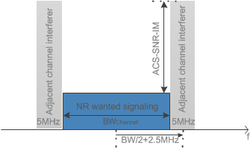
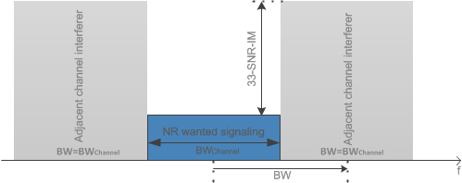
ACS | UE
For FR1, different ACS minimum requirement are specified for bands below 2.7GHz and bands above 3.3GHz
For bands below 2.7GHz, ACS is scaled for channel BW larger than 10MHz to keep the same 33dB ACS as LTE
For bands above 3.3GHz, 33dB ACS is specified for all channel bandwidth
For FR2, the ACS requirement is verified with the test metric of EIS.
28GHz band: 23dB ACS
39GHz band: 22 dB ACS
It is not possible to directly measure ACS, instead the lower and upper range of test parameters are chosen to verify ACS

Slide 20
ACS | BS
For BS 1-C and BS 1-H, same conductive ACS requirements as LTE is specified for all NR BS classes
For BS 1-O, ACS is applied when AoA of wanted signal and interference signal are within the minSENS RoAoA.
For BS 2-O ACS is applied when AoA of wanted siganl and interference signal are within FR2 OTA REFSENS RoAoA. Requirements are derived based on co-existence study
24dBc for 24.24 – 33.4 GHz frequency range.
23dBc for 37 – 52.6 GHz frequency range.

Slide 21


For more Information:
info@3gpp.org
www.3gpp.org
Search for WIDs at http://www.3gpp.org/specifications/work-plan and http://www.3gpp.org/ftp/Information/WORK_PLAN/ (See excel sheet)

